Slide 1
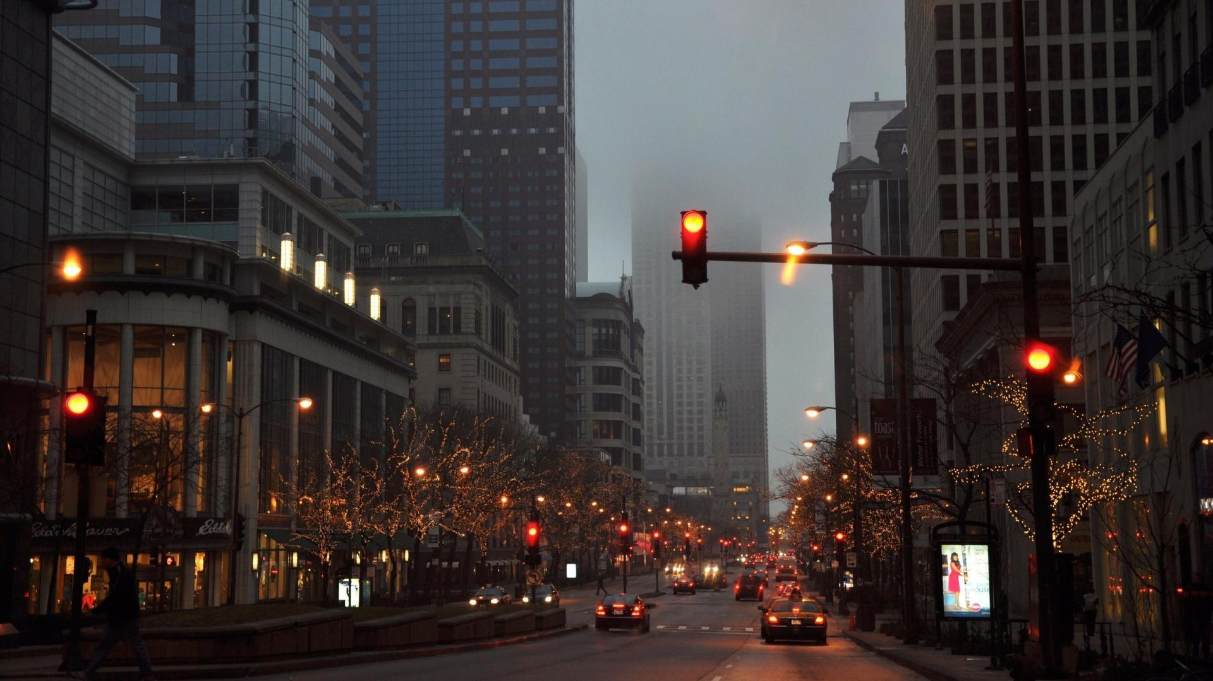
CHICAGO Traffic Accidents Analysis
Period 2019-2024

Slide 2
THEMES COVERED
PROJECT OVERVIEW
ANALYSIS STORY POINTS
MACHINE LEARNING MODELS

Slide 3
OVERVIEW
Chicago experiences nearly 25,000 crashes annually, emphasizing the need for increased caution and awareness while driving.
This project analyzes the Chicago crashes dataset to identify patterns, high-risk areas, and contributing factors.
Insights from the analysis could be used for the public and assist city planners in improving traffic safety measures.
Machine learning techniques are used to predict crash likelihood, showcasing the power of business intelligence in interpreting complex data.
The findings aim to promote safer driving practices and support data-driven decisions for urban safety enhancements.
Notes:
Chicago experiences a significant number of crashes annually, with nearly 50,000 incidents on average, highlighting the need for increased awareness and caution while driving. This project analyzes the Chicago crashes dataset to uncover patterns and trends, such as high-risk areas, times, or contributing factors, offering valuable insights to the public and city planners.
Additionally, we applied machine learning techniques to predict crash likelihood under different conditions, showcasing how business intelligence can transform raw data into actionable knowledge. The findings aim to inform safer driving practices and support data-driven decisions for urban safety improvements.

Slide 4
ANALYSIS STORY POINTS
1
FACTORS OF CRASHES
3
PEAK TIMES FOR CRASHES
HIGH RISK AREAS FOR CRASHES
HOW PHYSICAL SITUATIONS AFFECTS CRASHES
2
4
5
ROLE OF WEATHER CONDITIONS

Slide 5
Factors of Crashes

Slide 6
The Most Common Reason for crashes are related to experience
Failed to yield the right of way (58000 Crashes)
Following too closely (47000 Crashes)
Improper Overtaking/Passing (26000 Crashes)
Improper Backing (20000 Crashes)
Improper lane usage (17000 Crashes)
Improper Turning (17000 Crashes)
Driving Skills (18000 Crashes)

Slide 7
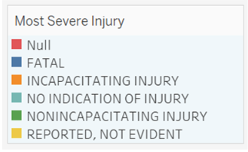
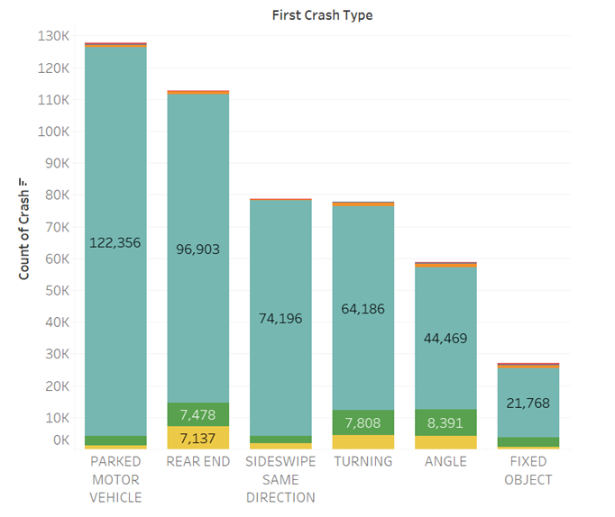
Most crash types are stationary vehicles and rear end from other cars
Parked Motor Vehicle has more crashes than active
Followed by more active crashes such as rear-end or turning
Worth to noted that most of them resulted in no injury

Slide 8
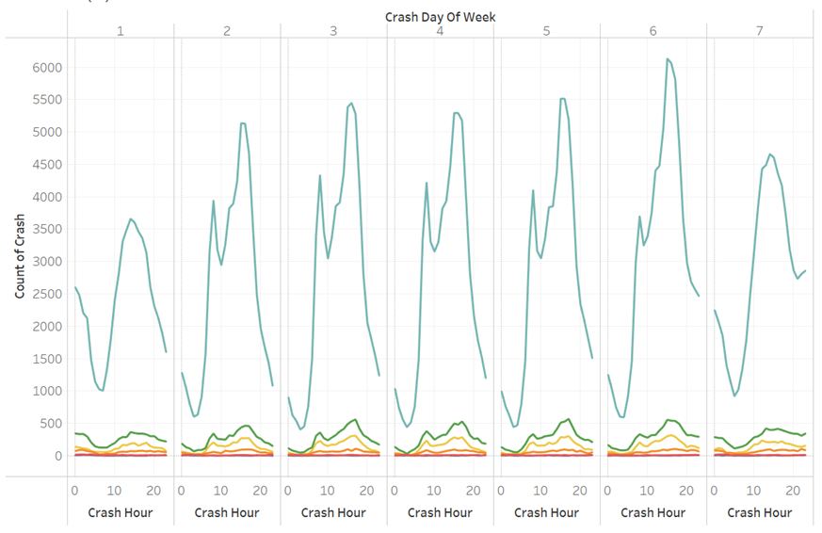
Crashes happened more in weekdays night
Crashes occurred mainly on Fridays but lower on the weekends
Most of them happened late at night on the weekdays
Although most of the crashes are no indication and followed by non-incapacitating injury

Slide 9
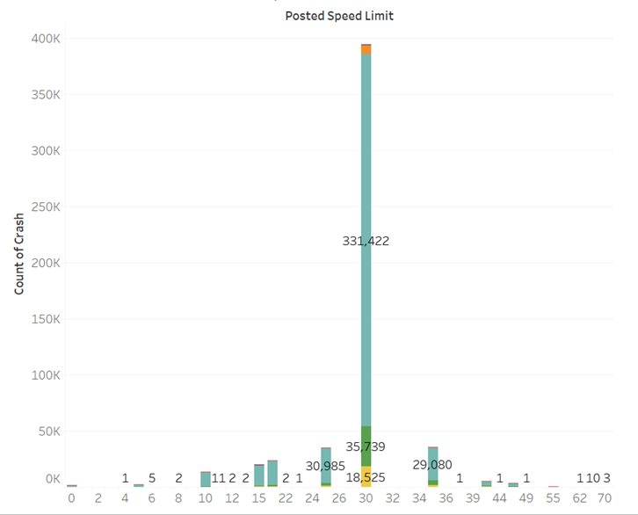
30 Mph speed limit lanes has more crashes than lower or higher
Most crashes happened in around 30 Miles per Hour
Higher speed limit has similar number to the smaller speed limit

Slide 10
High-risk areas for Crashes

Slide 11
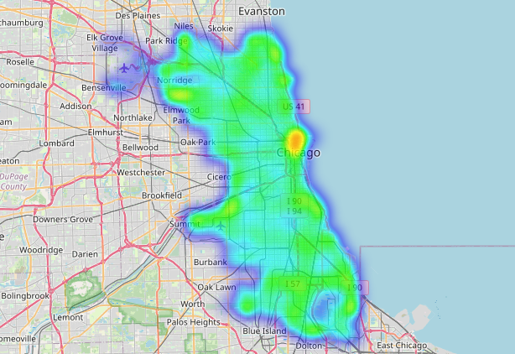
High-risk areas
Highest crashes in downtown Chicago
Hypothesized reasons:
High traffic
High pedestrian density

Slide 12
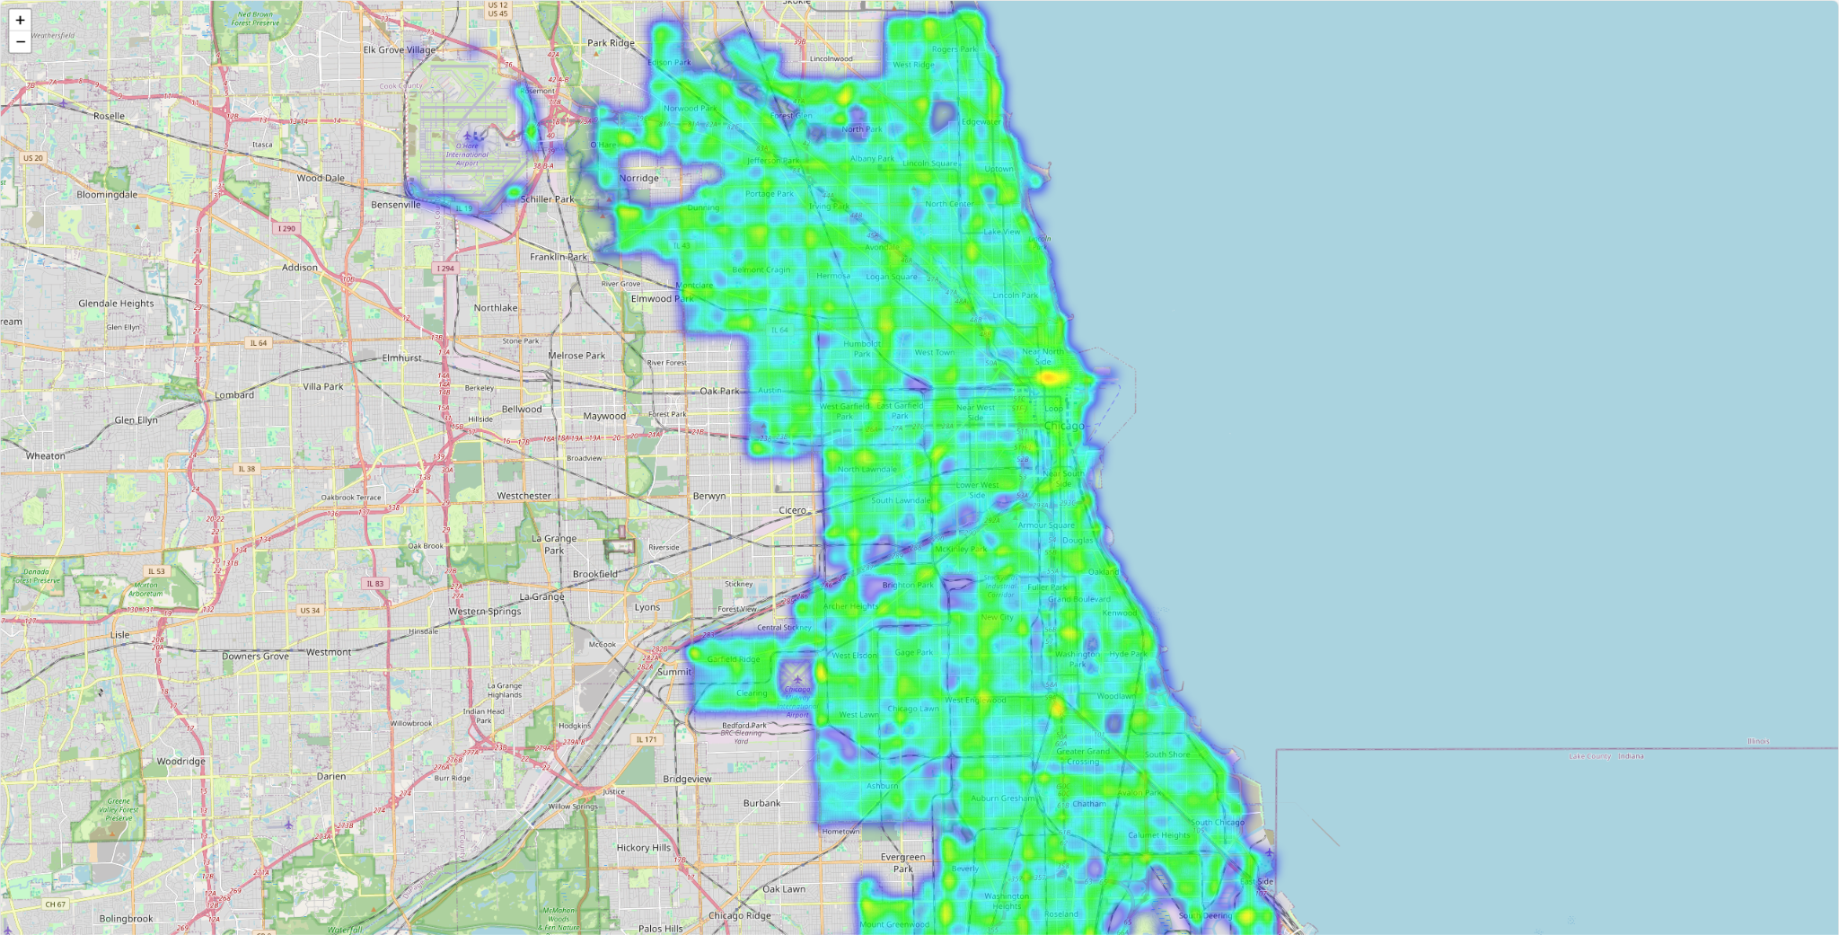

Slide 13
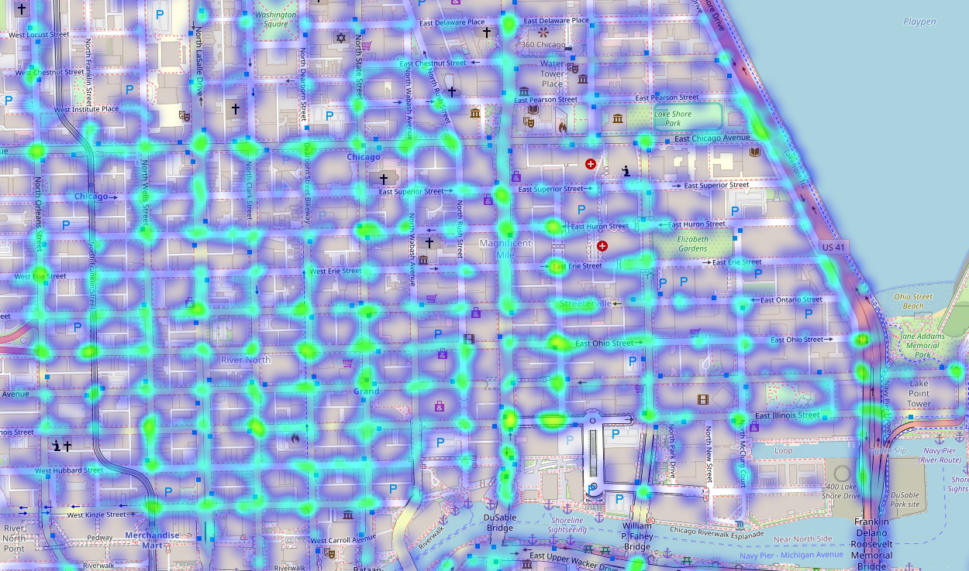

Slide 14
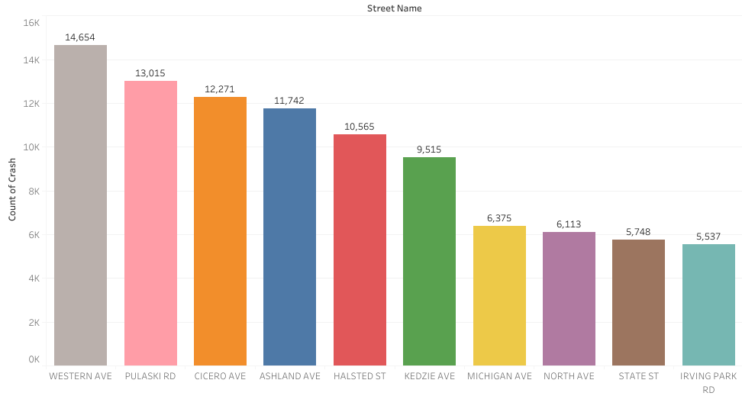
Streets with Most Crashes
Highest crashes on Western Avenue and Pulaski Rd
Hypothesized reasons:
Road Length
Traffic Volume

Slide 15
Peak Time Crash
Break Down

Slide 16
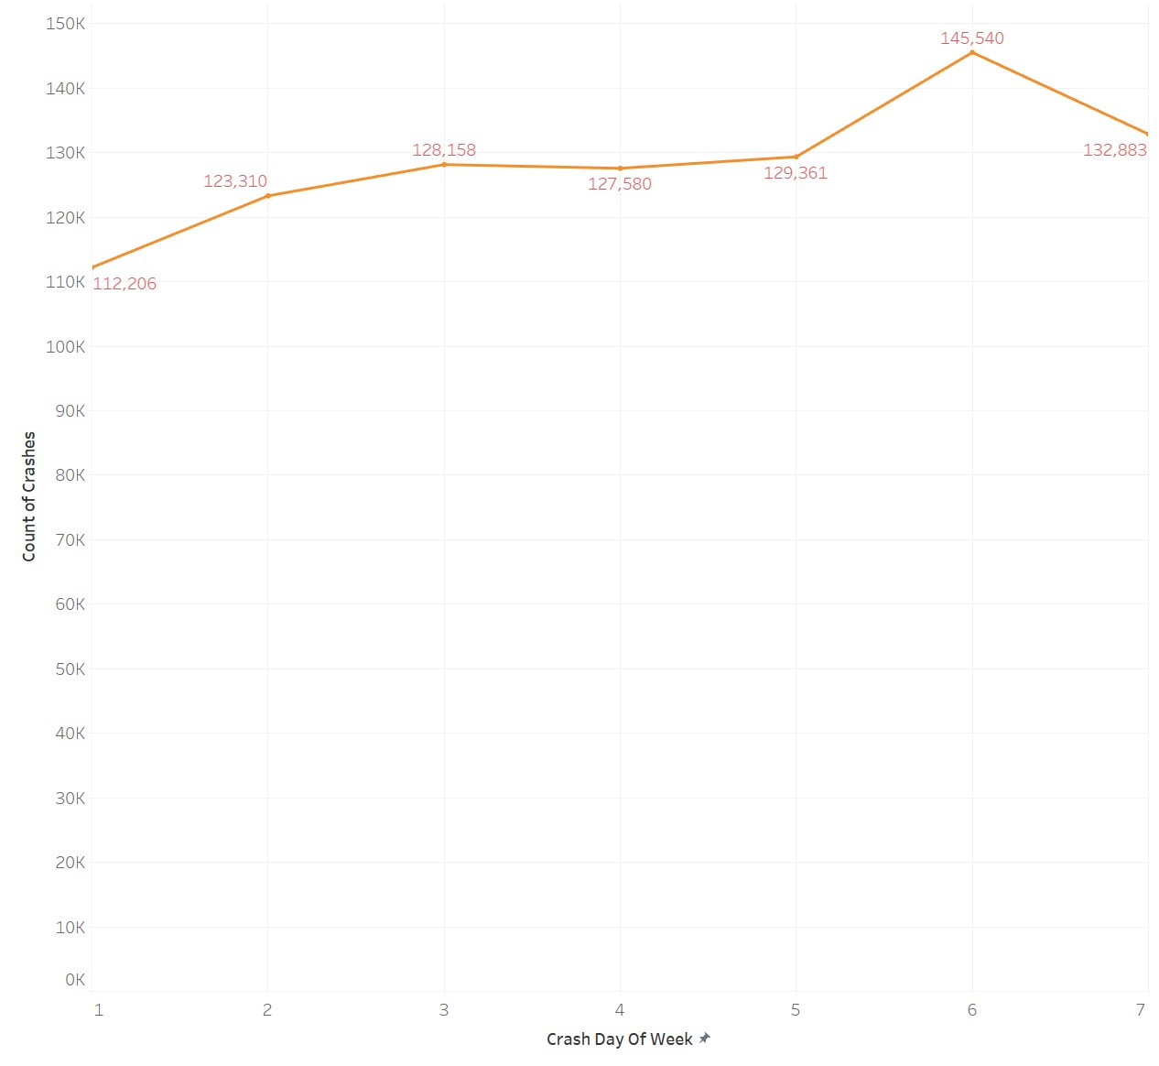
Crash Counts By Day Of Week
Monday to Thursday (Days 1-4): Gradual increase in crashes. Weekday commuting patterns and increased traffic volume.
Friday (Day 5): Highest Crash count for weekdays, influenced by end-of-week fatigue, increased traffic, and evening social activities.
Weekend(Day 6 and 7): Highest crash count, driven by leisure travel, late-night activities, and more vehicles on the road.

Slide 17
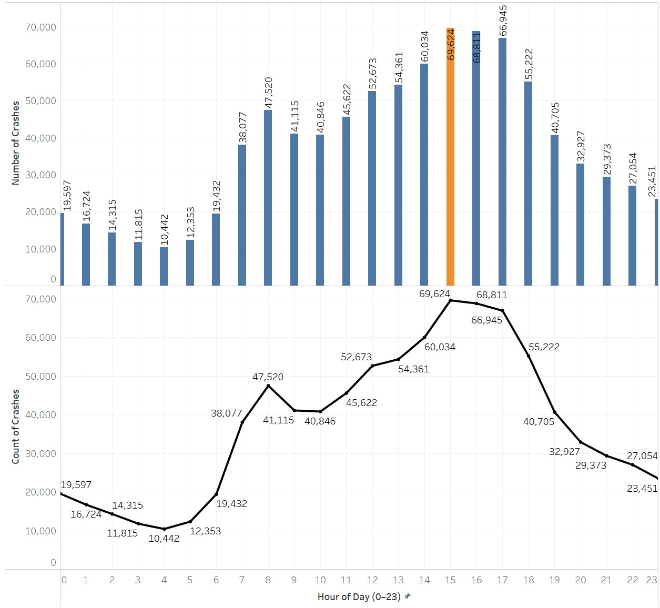
Traffic Crashes By Hour of Day(0:00 to 23:00)
Afternoon Commute (14:00 to 17:00):Crash numbers are significantly higher during this period, with the peak observed around 14:00-15:00.
Early Morning Hours (00:00 to 05:00):Reduced traffic volume and low crash count.
Morning Commute (06:00 to 09:00): rise in traffic count.
Midday (10:00 to 13:00):Increased overall road activity and incline in crash count
Evening and Late-Night Hours (18:00 to 23:00):
Crash numbers decline steadily after 17:00, likely due to decreasing road activity.

Slide 18
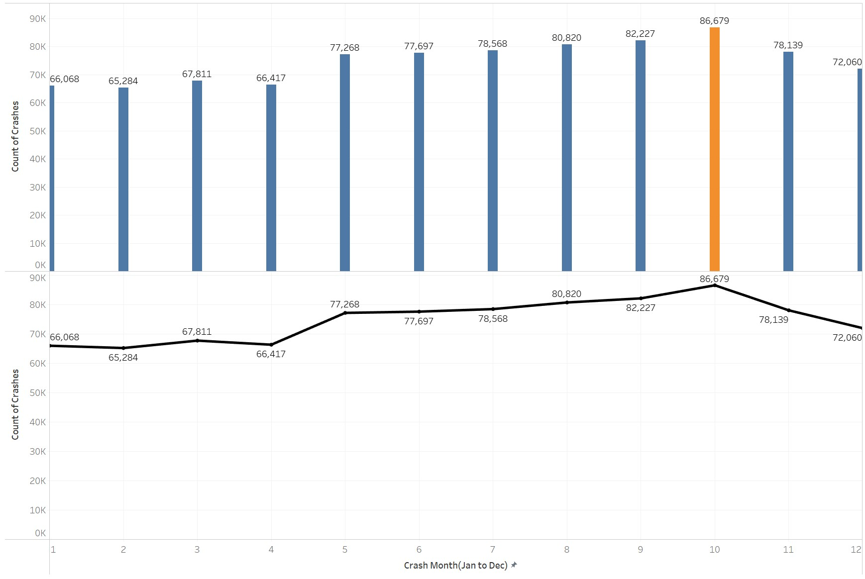
Crash Counts By Month
January to April (Months 1-4): Crash counts are relatively stable, with a slight dip in February. Lower traffic volume in winter months and fewer outdoor activities.
May to August (Months 5-8): Crash counts steadily increase, peaking in August.Summer travel, vacation driving, and higher pedestrian/cyclist activity in warm weather.
September to October (Months 9-10): The highest crash counts occur in October. School reopenings, increased commuting traffic, and shorter daylight hours starting to affect visibility.
November to December (Months 11-12): Crashes decline as the year ends. Holiday travel calming traffic, weather-related caution, and less outdoor road activity

Slide 19
Traffic Gadgets and Road Condition Affecting Crashes

Slide 20
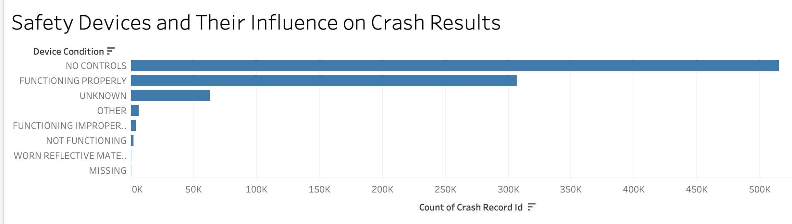
Safety Devices and Their Influence on Crash Results
Key Insights:
No Controls: Over 350K crashes occurred without any safety controls, the highest category.
Functioning Devices: Properly functioning devices also account for a significant number of crashes, suggesting other influencing factors.
Data Gaps: Many crashes have unknown device conditions, highlighting the need for better reporting.

Slide 21
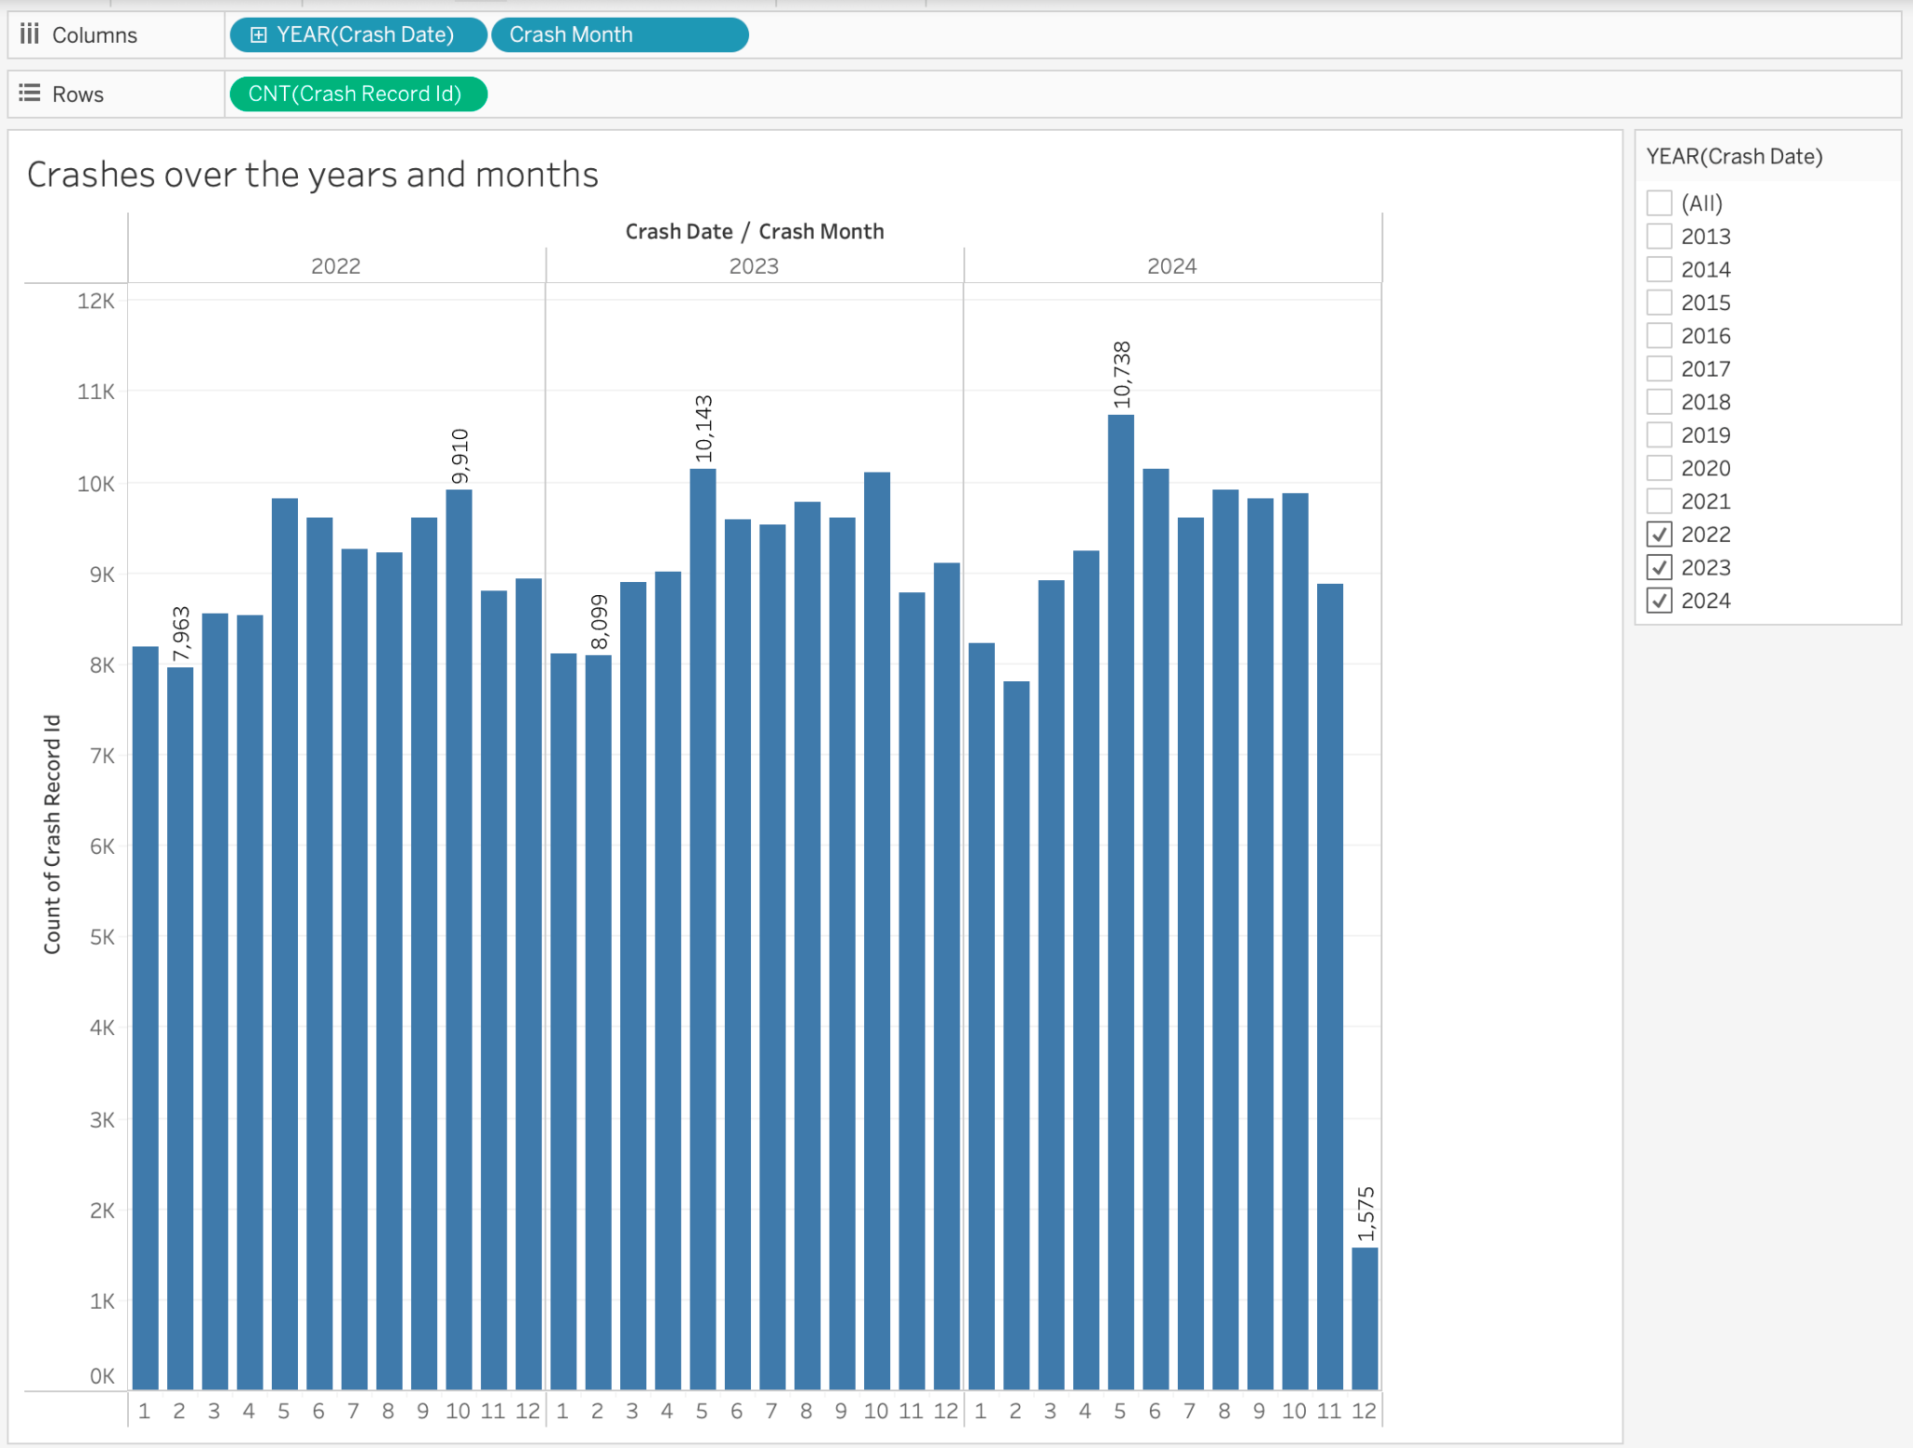
Crash Incidents by Month for the Past 3 Years
Crashes show consistent seasonal pattern across years
Highest crash counts observed in winter months
2023 has the peak crash count at around 10,143 in May
2024 projects lower overall crash counts compared to prior years
Data enables identification of high-risk crash periods

Slide 22
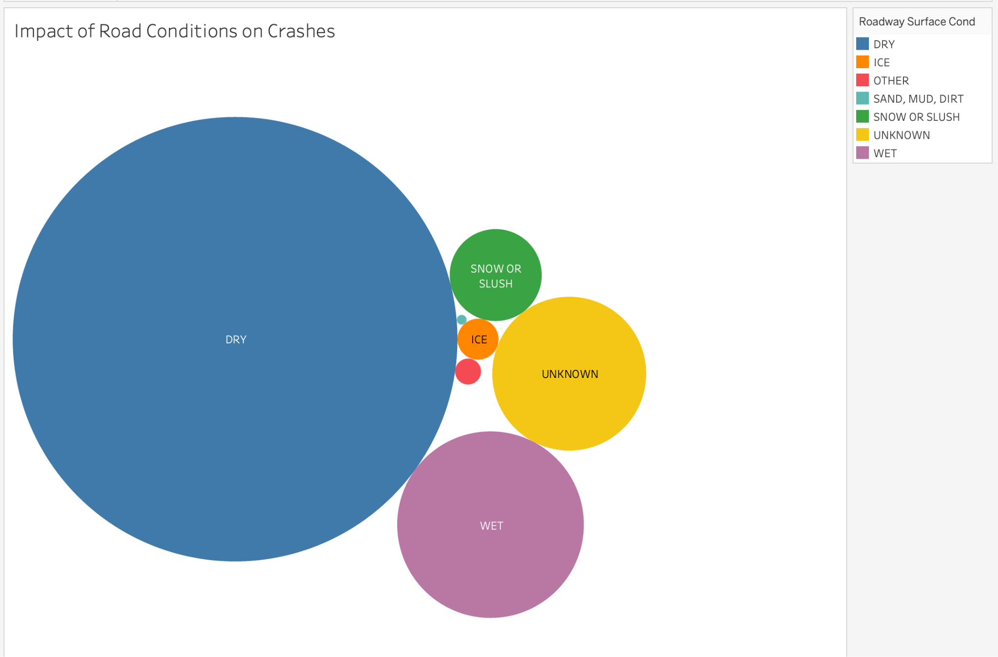
Impact of Road Conditions on Traffic
Pie chart shows road condition impact on crashes
Largest slice is "DRY" - most common crash scenario
Other conditions include snow, ice, unknown

Slide 23
Role of weather condition

Slide 24
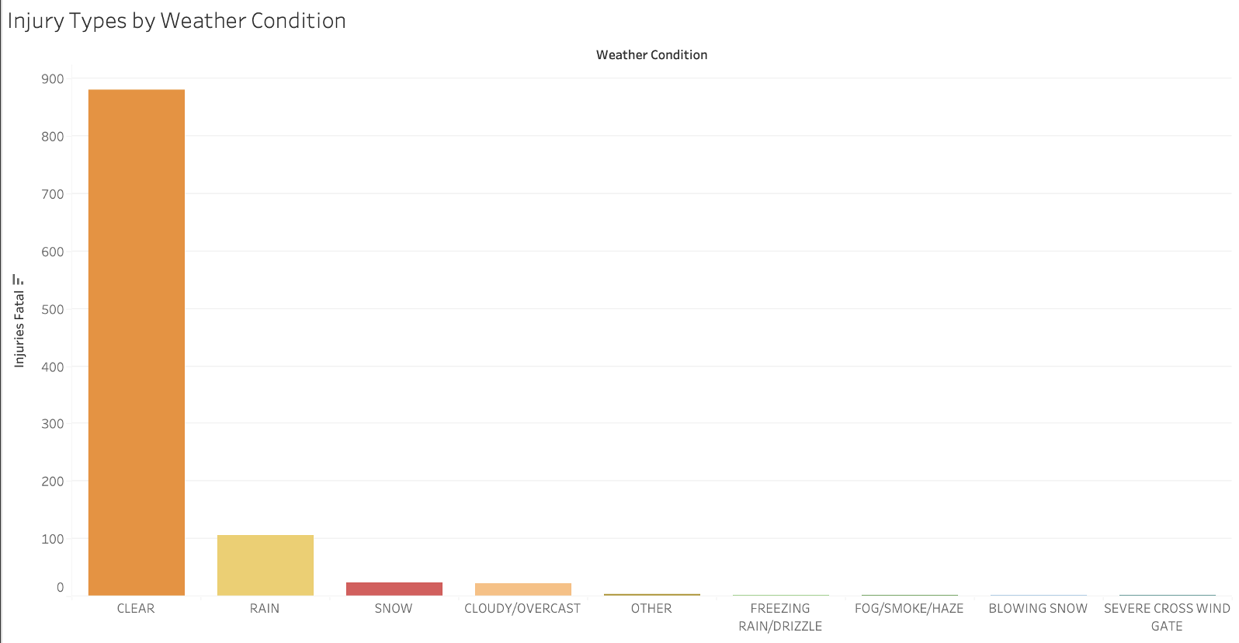
Fatal injuries by Weather Conditions
High Fatalities in Clear Weather
Lower Fatalities in Adverse Weather Conditions

Slide 25
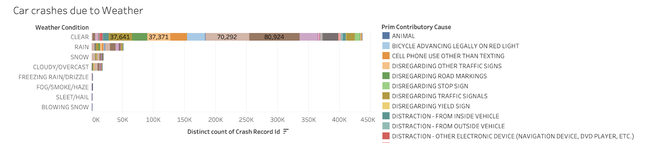
Number of crashes due to weather
Following too closely
Failing to yield on stop sign
The largest share of crashes occurs during clear weather conditions. Overspeeding and ignoring stop signs dominate as primary causes
Adverse weather (e.g., rain, snow, fog) accounts for a significantly smaller number of crashes. The reasons, however, are similar to that of clear weather.

Slide 26
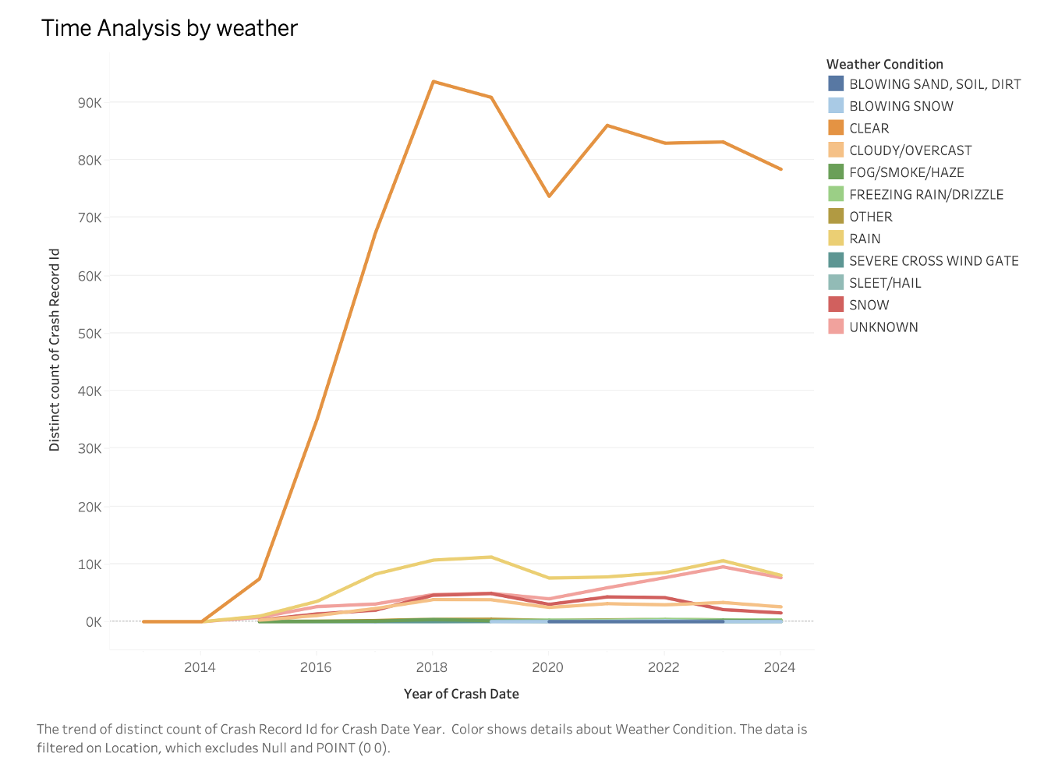
Temporal analysis of crashes by weather
A significant drop in crashes during clear weather is observed during 2019-2021 period. Other weather conditions also show slight decreases.
Crashes in adverse weather remain low and stable, likely due to reduced traffic and cautious driving.

Slide 27
Machine Learning Models to Predict Fatality in Crashes

Slide 28
Data Preparation Steps
Handling Null Values
Ensuring Proper Formatting of our Predictors
Factorising categorical predictors in our analysis

Slide 29
Dependent Variable:
Injuries_Fatal
Independent Variables:
Weather_Condition, Road_Defect, Roadway_Surface_Cond, Alignment, Trafficway_Type, Device_Condition, Posted_Speed_Limit

Slide 30
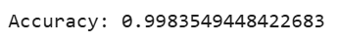
Logistic Regression
Random Forest

Slide 31
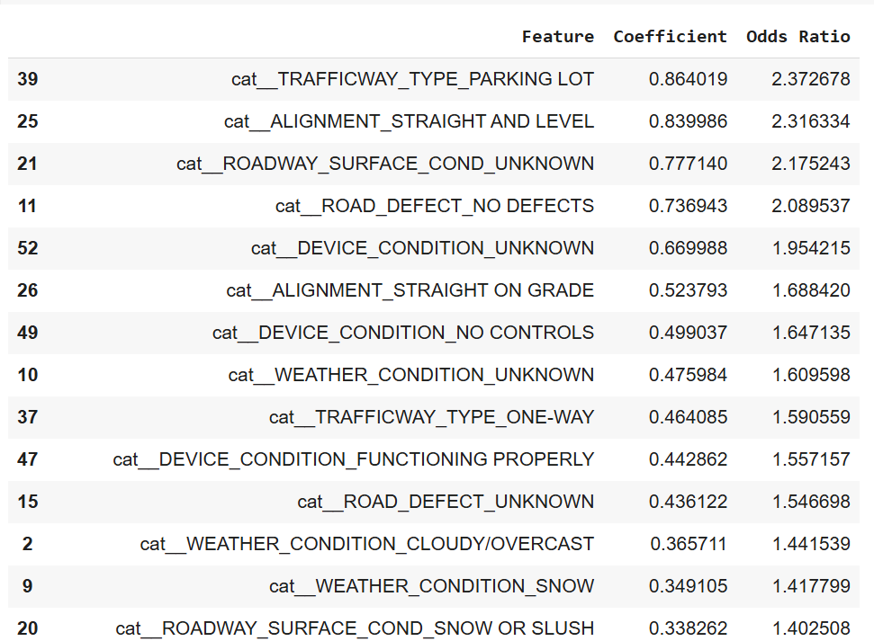
IMPORTANT FEATURES

Slide 32
THANKYOU!
ANY QUESTIONS?

Slide 33
Data Source
Chicago, C. of (2024) Traffic crashes - crashes: City of chicago: Data Portal, Chicago Data Portal. Available at: https://data.cityofchicago.org/Transportation/Traffic-Crashes-Crashes/85ca-t3if/about_data (Accessed: 10 December 2024).

